Slide 1
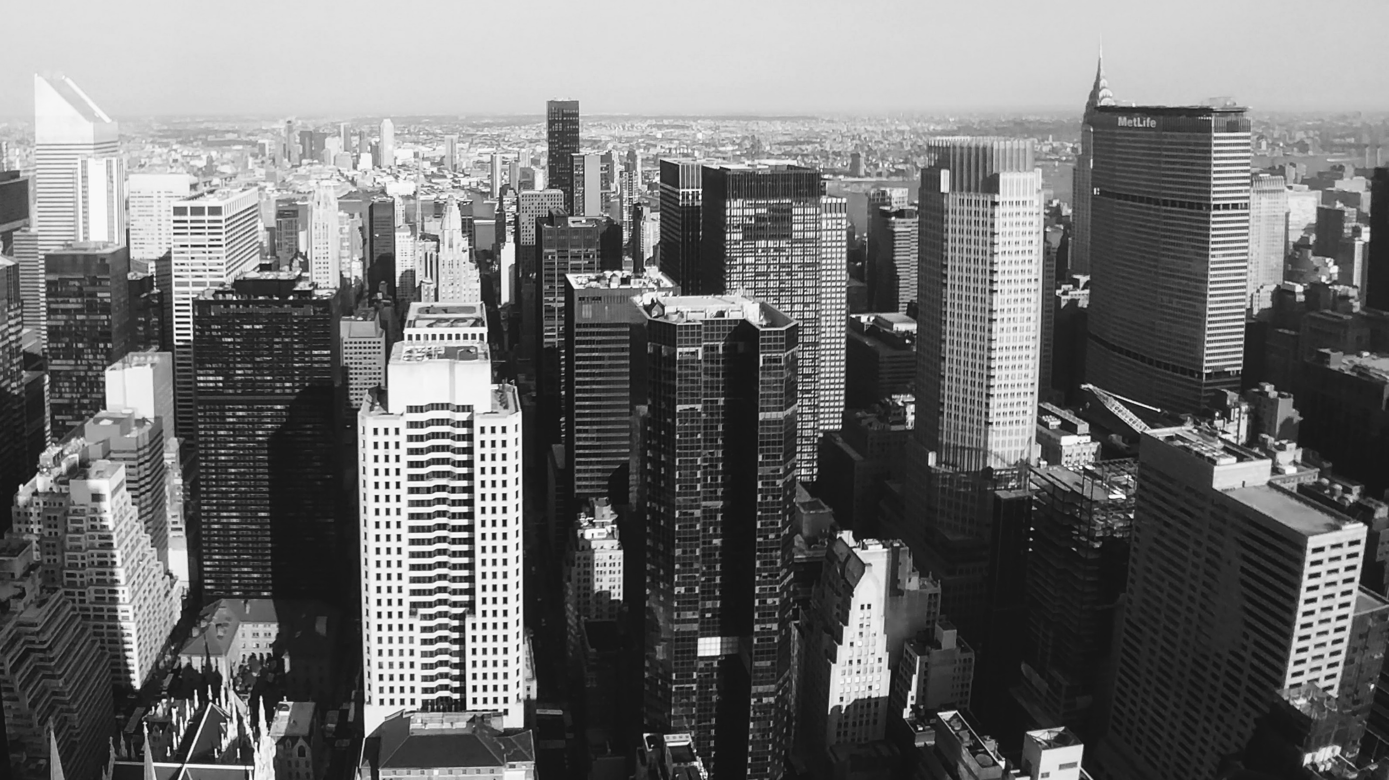
Folie 1
Segmentation of Neighbourhoods in Brooklyn
based on venues available

Slide 2
Folie 8
Setting
Goal: Getting people a sense of where in Brookyln they should move dependent on which venues they prefer nearby.
Approach: Cluster neighbourhoods based on zip code areas with an k-means algorithm
Data: Datasets from data.world and public.opendatasoft.com for zip code area data, foursquare developer API for venues.
Software: Calculation in Python in a Jupyter Notebook using the IBM Cloud.
1

Slide 3
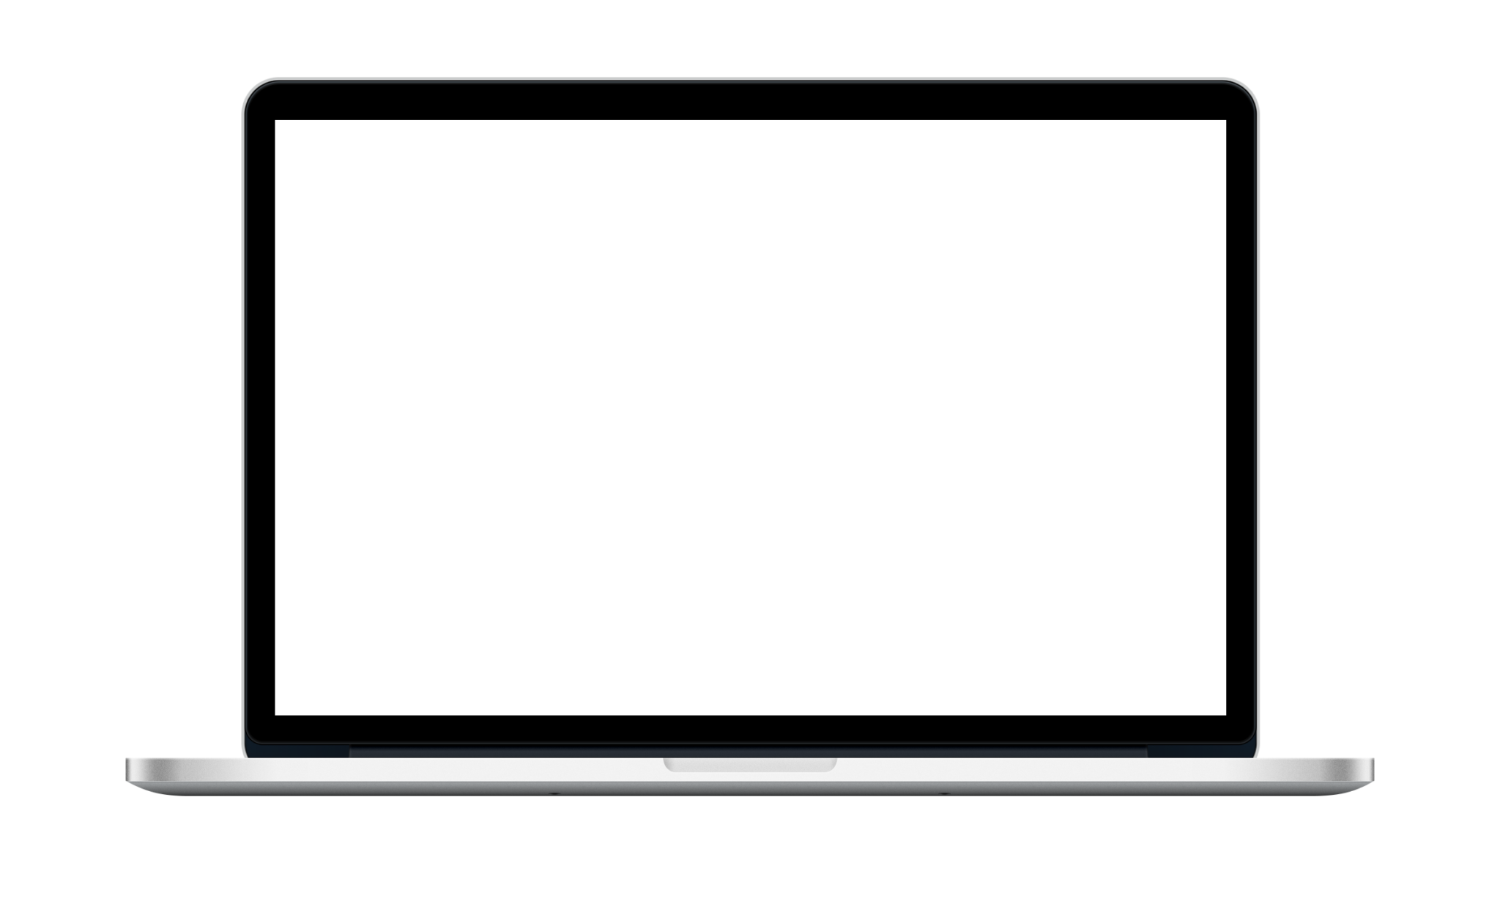
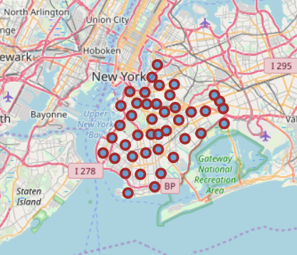
Folie 10
Zip Code Areas
All in all, 46 zip code areas where used.
2

Slide 4
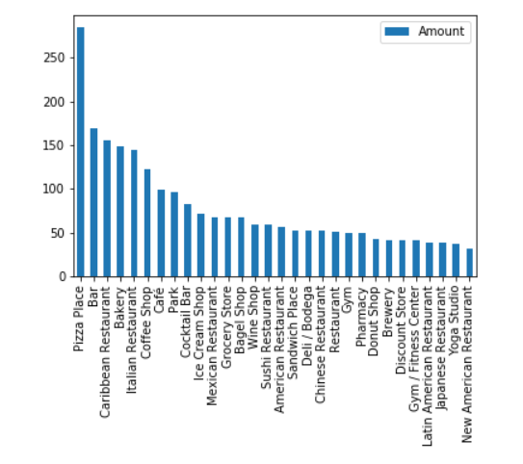
Folie 10
Venues extracted from Foursquare
Pizza places highly dominate in quantity, even more if you take into account that Italian restaurants are the fifth most common venue category. Most common places are related to food or drinks (restaurants, bars, cafés) or sport (gyms, yoga studios).
3

Slide 5
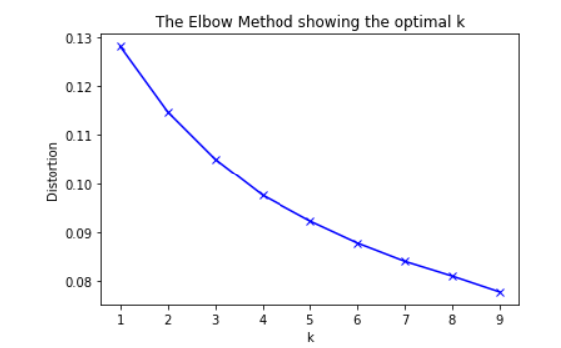
Folie 10
Scree test
To examine the optimal amount of clusters, a Scree-Test was performed to see how much of additional variance would be explained by adding an additional cluster. It becomes visible, that this is not an extremely clear result, as there is some room for interpretation over the optimal cluster amount. However, four clusters were chosen as the angle here is a little bit smaller.
3

Slide 6


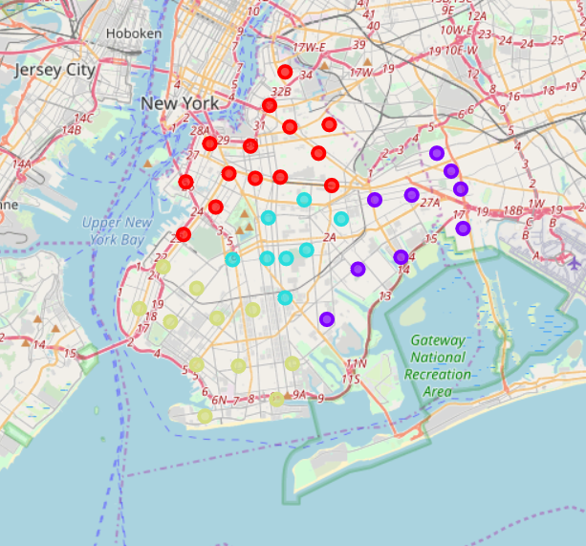
Folie 7
35 %
Applying k-means algorithm
25 %
In this folium map it becomes visible that the segmentation divides the borough relatively clear into four cluster, each one in the direction of Manhattan (red – cluster 0), Queens (violet – Cluster 1) and Staten Island (green – Cluster 3) as well as one in the center (turquoise – cluster 2).

Slide 7
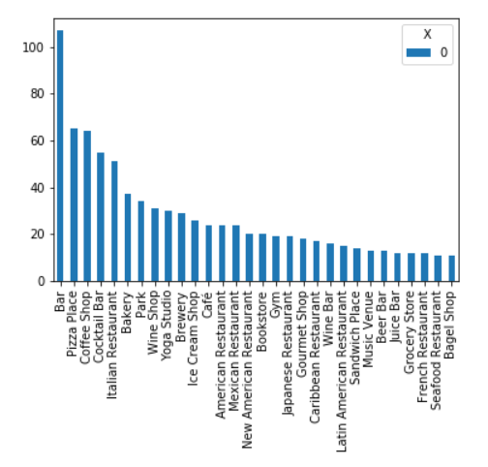
Folie 10
Cluster 0
It seems that you should move to a neighborhood close to Manhattan (cluster 0) if you are into bars. This is no surprise, as neighborhoods like Williamsburg are located in this cluster. It seems to be more a place for people that like to party. You find categories like “bar”, “cocktail bar”, “beer bar”, “wine bar”, “wine shop” or “brewery” amongst the most popular ones. It is also good for people that like to be outdoors, as there are many parks. Supermarkets are not as common as in the other clusters.
5

Slide 8
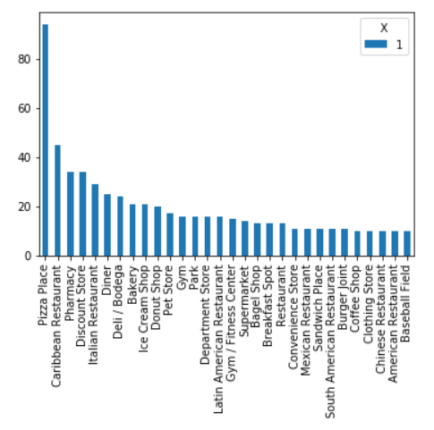
Folie 10
Cluster 1
The cluster nears Queens (cluster 1) is the right place for people that like pizza or Caribbean food. It has If you are into cafes or bars, better avoid moving here. However, there are plenty of pharmacies and moderate amounts of convenience stores and clothing stores.
6

Slide 9
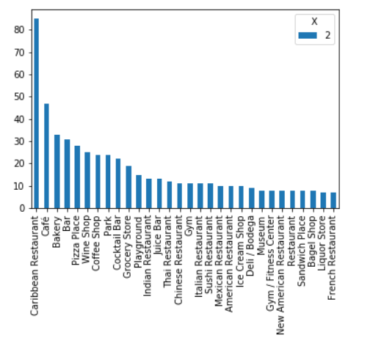
Folie 10
Cluster 2
The center cluster (cluster 2) has the advantage as well that it is near to all the other clusters. It is the perfect place for eating Caribbean food. There are also cafes / coffee shops and bars. It seems to be interesting for parents, as there are a lot of playgrounds and parks.
7

Slide 10
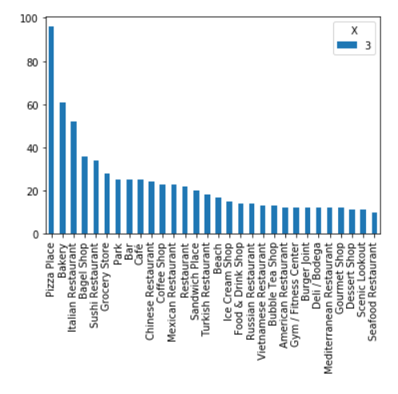
Folie 10
Cluster 3
Cluster 3 has a relatively high diversity of restaurant types (including sushi, Chinese, Turkish, Russian, Vietnamese), which seems to be interesting for foodies. A big plus is a high availability of grocery stores. It seems to be the only cluster with a moderate amount of beaches.
8

Slide 11

Folie 11
Thank you.

